Slide 1
Hash Chain Authentication
Dae Hyun Yum

Slide 2
Hash chain (a.k.a. key chain)
Cryptographic hash function
h: {0,1}* → {0,1}^{L}, v_{i} = h(v_{i+1}), for 0 ≤ i ≤ n−1
v_{i-k} = h^{k}(v_{i})
Hash chain
Hash chain is a sequence of hash values <v₀, v₁, …, v_{n}>.
v_{n}: the secret value (chosen uniformly at random)
v₀: the public value
h
v₀
v₁
v₂
v₃
…
v_{n-3}
v_{n-2}
v_{n-1}
v_{n}

Slide 3
Application: TESLA
Timed Efficient Stream Loss-tolerant Authentication
“Efficient Authentication and Signing of Multicast Streams over Lossy Channels,” IEEE Symposium on Security and Privacy, 2000.
Broadcast authentication protocol
Asymmetric key cryptography via time
Based on loose time synchronization
Delayed-disclosure of keys
Generate
h
v₀
v₁
v₂
v₃
…
v_{n-3}
v_{n-2}
v_{n-1}
v_{n}
Use/Reveal

Slide 4
Application: TESLA
Authentication at receiver
TESLA uses the key v_{i} at time interval i.
h
h
h
h
v₀
v₁
v₂
v₃
v₄
0
1
2
3
4
time
P₁
P₂
P₃
P₄
P₅
P₆
P₇
v₁
v₂
v₃

Slide 5


Application: certificate revocation
Certificate revocation system
“Efficient Certificate Revocation,” Technical Report MIT/LCS/TM-542b, MIT Laboratory for Computer Science, 1996.
If a certificate is valid for one year, v₀ = h³⁶⁵(v_{n}) is included in the certificate (v_{n}: secret value of CA).
On day d, certificate holder obtains v_{d} = h^{365-d}(v_{n}) from CA, which is used to prove that the certificate is still valid on day d
CA
Certificate holder
v_{d}=h^{365-d}(v_{n})
v₀ = h^{d}(v_{d})

Slide 6
Hash chain traversal (stateless version)
Recomputation
Compute v_{i} = h^{n-i}(v_{n}) from the secret value v_{n}.
Precomputation
Store all hash values in advance.
Time-space tradeoffs
Store some hash values and compute each hash value from the nearest stored value.
v₀
v₁
v₂
…
v_{i}
…
v_{n-3}
v_{n-2}
v_{n-1}
v_{n}
v₀
v₁
v₂
v₃
v₄
…
v_{n-3}
v_{n-2}
v_{n-1}
v_{n}

Slide 7
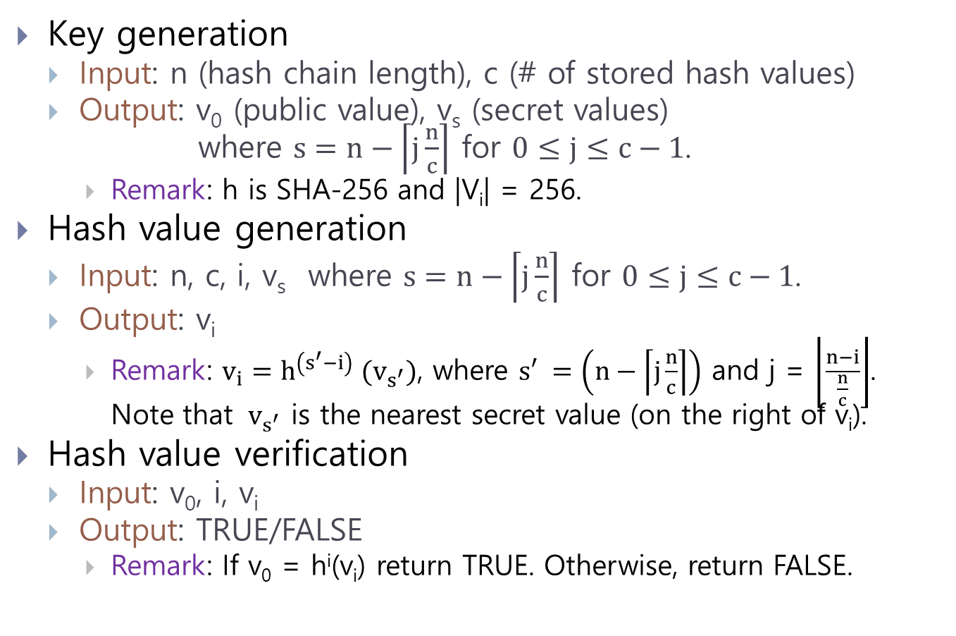
Hash chain algorithms: sample code
Key generation
Input: n (hash chain length), c (# of stored hash values)
Output: v₀ (public value), v_{s} (secret values) where $s=n−\left\lceil j\frac{n}{c}\right\rceil$ for $0≤j≤c−1$.
Remark: h is SHA-256 and |V_{i}| = 256.
Hash value generation
Input: n, c, i, v_{s} where $s=n−\left\lceil j\frac{n}{c}\right\rceil$ for $0≤j≤c−1$.
Output: v_{i}
Remark: $v_{i}=h^{\left(s^{′}−i\right)}{ (v}_{s^{′}})$, where $s′ =\left(n−\left\lceil j\frac{n}{c}\right\rceil \right)$ and j = $\left\lfloor \frac{n−i}{\frac{n}{c}}\right\rfloor$. Note that ${ v}_{s^{′}}$ is the nearest secret value (on the right of v_{i}).
Hash value verification
Input: v₀, i, v_{i}
Output: TRUE/FALSE
Remark: If v₀ = h^{i}(v_{i}) return TRUE. Otherwise, return FALSE.

Slide 8

daehyun.yum@gmail.com

